Slide 1
Mapping Data Flow with Azure Data Factory Activities using ADF Pipeline
-Kanak Agrawal
-Akash

Slide 2
Contents
Project Overview
Project Objective
Workflow
Architectural Diagram
Technologies and Tools
Task Performed
Result
Conclusion

Slide 3
Project Overview
Mapping Data Flow with Azure Data Factory Activities using ADF Pipeline
Project Objective
This project aims to illustrate the effectiveness of Mapping Data Flow in Azure Data Factory pipelines for streamlined data transformation. It showcases the design, development, and deployment of transformation processes using a visual interface, demonstrating orchestration within ADF pipelines.

Slide 4
Workflow
Data Ingestion
Data Preparation
Data Transformation
Data Loading
Data Validation
Data Monitoring and Management
Schedule Execution and Validation
Error Handling and Recovery
Data Retention and Archiving

Slide 5
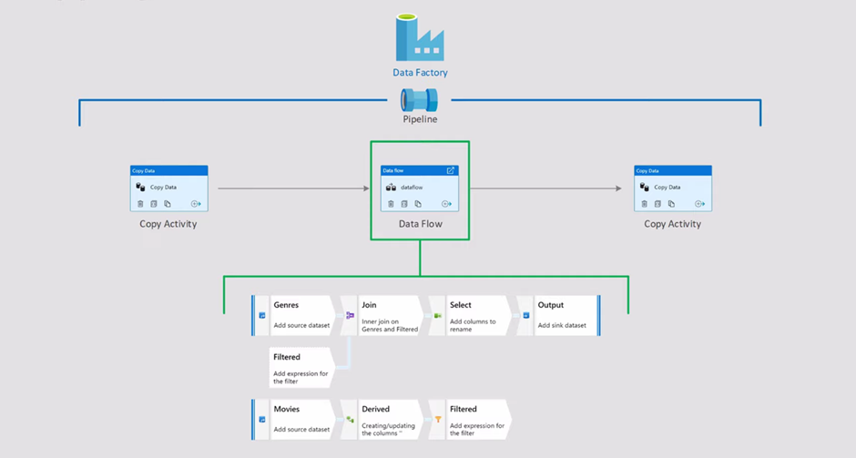
Architectural Diagram
Fig 1 Shows the Mapping of Data Flow

Slide 6
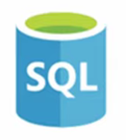



Technologies and Tools used
Azure Data Factory
Azure Blob Storage
Azure Data Lake Gen
Azure SQL Database

Slide 7
Tasks Performed
Project Setup
Data source identification
Data Preparation
Data Transforming Logic Design
Azure Data Factory Pipeline Creation
Data Ingestion
Data Transformation

Slide 8
Tasks Performed
Data Enrichment
Data Loading
Data Validation
Monitoring
Security Compliance
Documentation
Testing and Validation
Deployment and Maintenance

Slide 9
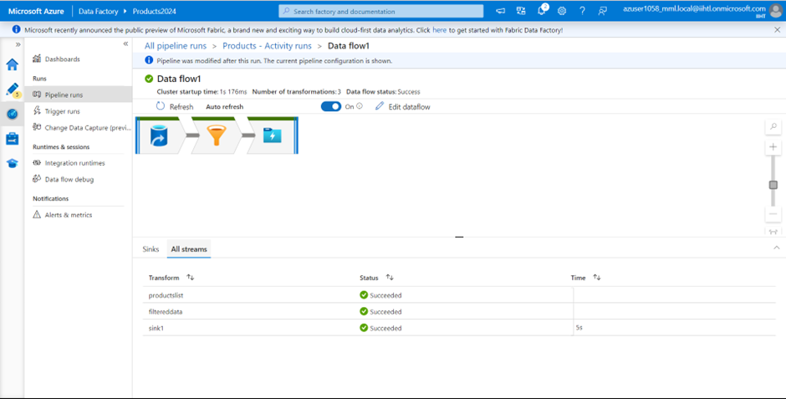
Result
This is the output of the execution completed successfully

Slide 10
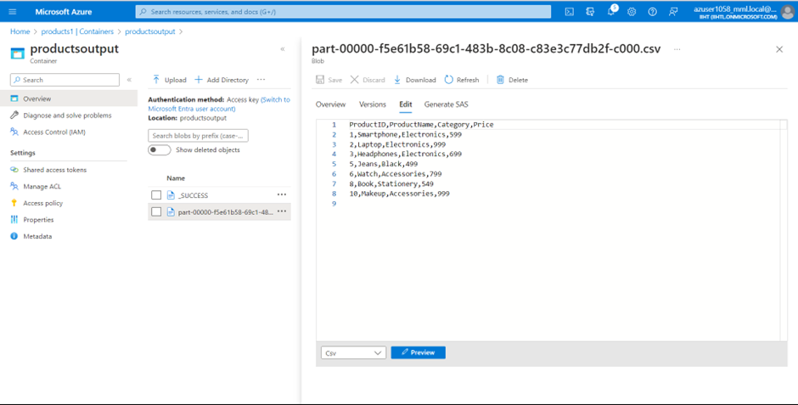
Result
This the final output of the project and Mapping of Data Flow

Slide 11
Conclusion
By leveraging Mapping Data Flow with Azure Data Factory activities, organizations can streamline their data transformation workflows, improve productivity, and accelerate insights delivery from raw data to actionable insights. This project provides a comprehensive overview of how Mapping Data Flow can be utilized within Azure Data Factory pipelines to achieve efficient data processing and transformation tasks in a cloud-based environment.

